Slide 1


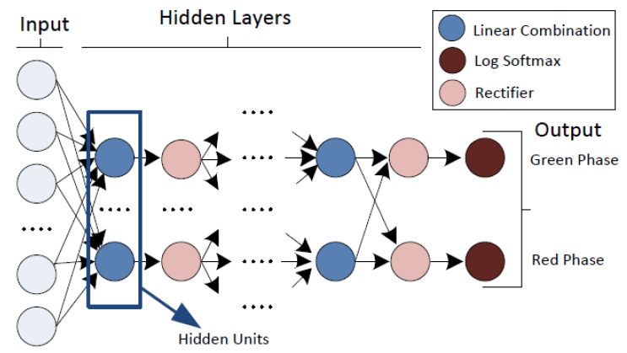
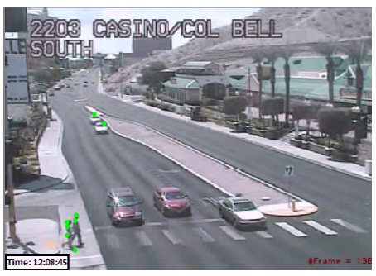
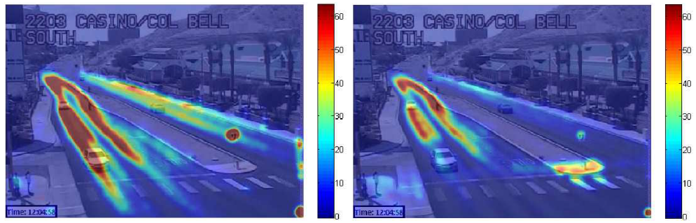
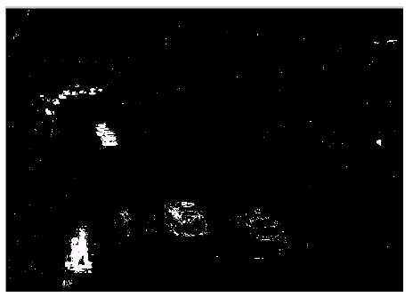
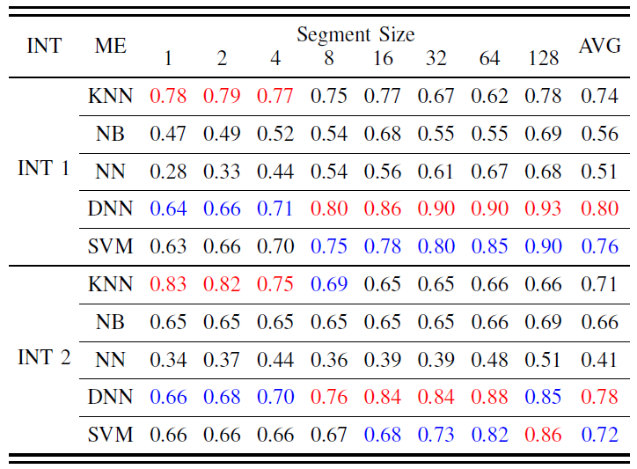
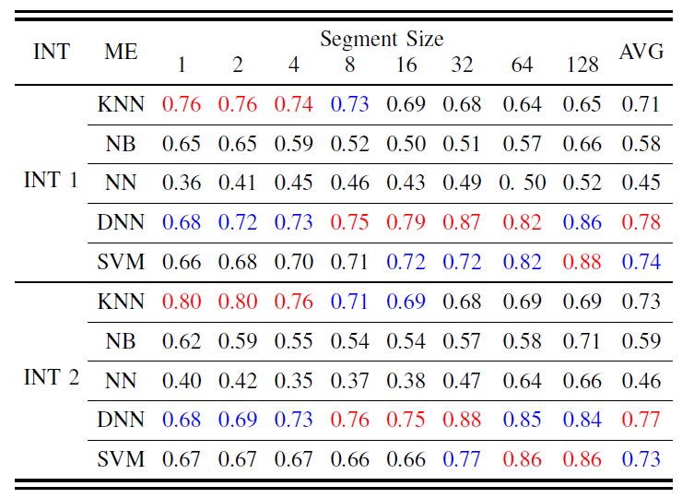
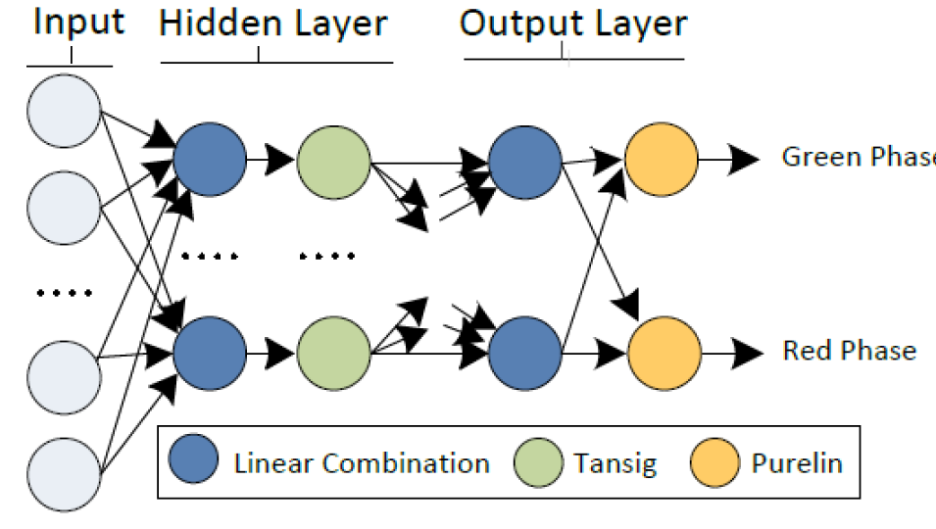
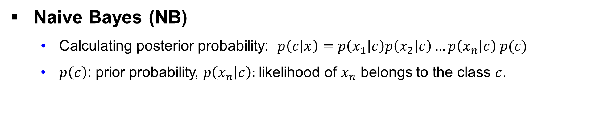

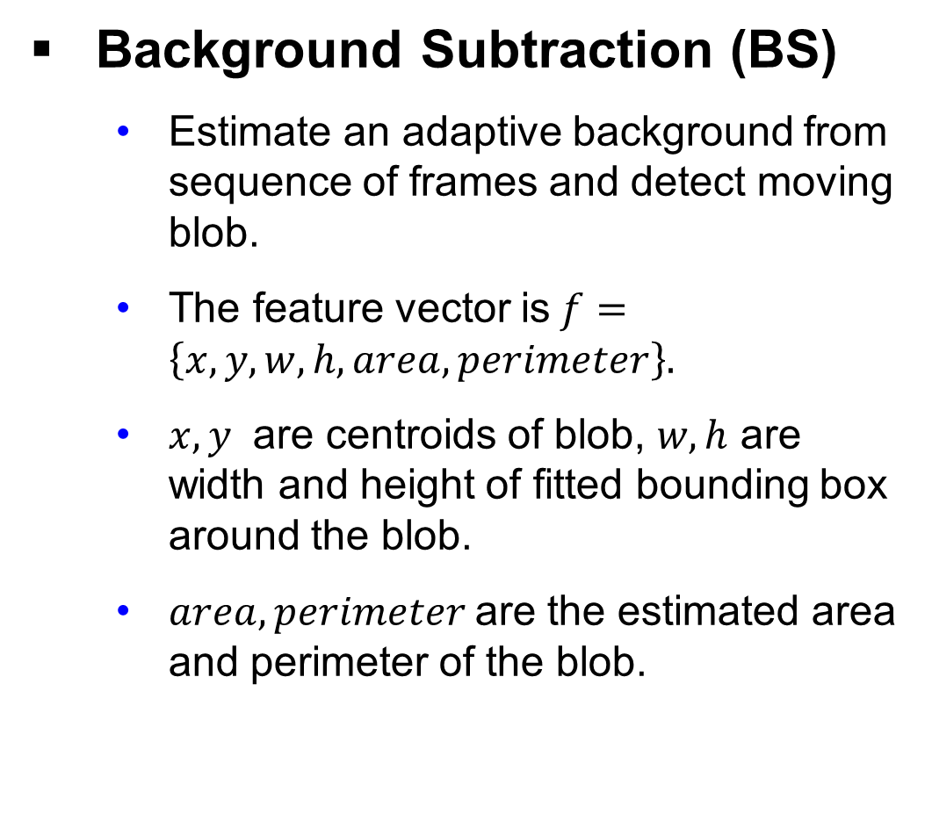
Your Project Tittle Goes Here
Team Leader:
Team Members:
Industry Sponsor
Industry Advisor (if any)
Faculty Advisor
Electrical Engineering and Computer Science, Cleveland State University, Cleveland, OH 44108
XX
Team.Leader@vikes.csuohio.edu
Abstract
Deep Neural Network (DNN)
Adding more hidden layers and rectifiers (e.g., ReLUs) .
Adding one hidden layer when feature segment size is increased.
Dealing with complex functions to provide a model with better accuracy.
Traffic signal phases can be inferred through traffic cameras in order to detect temporal violations of road users. Moving features are extracted and labeled according to two traffic signal lights (i.e., green, red) and different learning methods such as K Nearest Neighborhood (KNN), Naive Bayes (NB), Neural Network (NN), Deep Neural Network (DNN) and Support Vector Machine (SVM) are applied on training data. The experimental results of two different intersection videos shows that an accuracy of higher than 90% can be achieved by DNN and SVM when the feature size is appropriately selected.
Support Vector Machine (SVM)
Binary SVM is one of the most popular binary classifiers due to its ability to discriminate between classes of green and red phases.
Fig 4: Deep Network
Experimental Results
Introduction and Background
Feature Preparation and Training
Feature vectors are generated for BS and OF.
Arranged into different segment sizes.
Labeled by 0 or 1 indicating traffic signal state
Optical Flow (OF)
Detect Harris corners on moving objects and find matches by optical flow.
The feature vector is$f=\left\{x_{1},y_{1},x_{2},y_{2},m,θ\right\}$.
$x_{1},y_{1},x_{2},y_{2}$ are feature point coordinates for current and next frames, $m=\sqrt{{(x_{2}−x_{1})}^{2}+{(y_{2}−y_{1})}^{2}}$ , $θ=\tan^{−1}({\frac{y_{2}−y_{1}}{x_{2}−x_{1}})}$.
Fig 1: Moving feature collection using Harris corners with optical flow
Background Subtraction (BS)
Estimate an adaptive background from sequence of frames and detect moving blob.
The feature vector is$f=\left\{x,y,w,h,area,perimeter\right\}.$
$x,y$ are centroids of blob, $w,h$ are width and height of fitted bounding box around the blob.
$area,perimeter$are the estimated area and perimeter of the blob.
Fig 5: Heat-maps of training data for different signal phases (INT 1)
Accuracy Evaluation
Accuracy: Number of true predictions over total number of predictions.
Highest accuracy: red color
Second highest accuracy: blue color
KNN works better when feature vector size is small.
Accuracy > 74%
When feature segment size is increased, SVM and DNN become quite effective.
DNN and SVM reach an accuracy of 93% and 90%.
Comparison of two methods indicates relatively similar results.
BS has better performance for INT 1.
Different movement areas for pedestrians and vehicles.
BS has slightly better performance for INT 2.
Lack of pedestrian movements.
Features from more road users are usually collected for BS.
Table 1: Accuracy of learning methods (ME) using BS
Fig 2: Blob feature collection using background subtraction
System Design (and or Algorithm)
The collected features are labeled with respect to their traffic phase for the training purpose.
Table 2: Accuracy of learning methods using OF
System Overview
Implemented with C++ using OpenCV.
Evaluating two intersection videos of Las Vegas (INT1, INT2).
Trained with MATLAB R2016a for KNN, NB, NN, SVM.
Naive Bayes (NB)
Calculating posterior probability: $p\left(c\left|x\right.\right)=p\left(x_{1}\left|c\right.\right)p\left(x_{2}\left|c\right.\right)…p\left(x_{n}\left|c\right.\right) p(c)$
$p\left(c\right)$: prior probability, $p\left(x_{n}\left|c\right.\right):$likelihood of $x_{n}$ belongs to the class $c$.
Neural Network (NN)
One hidden layer with one output layer
Output range of [-1,1]
Output of linear combinations correspond to green or red signal phase.
Conclusion and Future Recommendations
What was learned through research: strengths and weakness of study
Possible applications of study (how it can be used)
Did the team met its project objectives
Recommendations
What would you do differently?
Any changes would you recommend for the experiment
Can you build on your findings to solve other problem
Fig 3: Shallow Network

